Slide 1
FRONT END PROJECT
Arora’s.com
INSTRUCTOR: MR.LOVISH ARORA
Name: Amuljot Singh
Roll no.: 2110990168
Group: G5

Slide 2

Table of contents
Introduction
Why Arora’s?
Goals
Challenges
Future Scope

Slide 3

Introduction
Welcome to the world of Arora’s.com, your ultimate destination for a seamless and gratifying online shopping experience. In this presentation, we'll take you on a journey through the incredible world of Arora's.com, an e-commerce platform designed to bring convenience, choice, and excellence right to your fingertips.

Slide 4

Why Choose Us?
Why should you choose Arora’s.com over other e-commerce websites? Here are a few compelling reasons:
Diverse Product Catalog
User-Friendly Interface
Secure Transactions
24/7 Customer Support

Slide 5

Goals
Customer Acquisition
Enhanced User Experience
Data Security
Social Proof
Customer Support

Slide 6

Challenges:
Time Management
Shopping cart and checkout
Content Creation
Design and User Experience (UX)

Slide 7
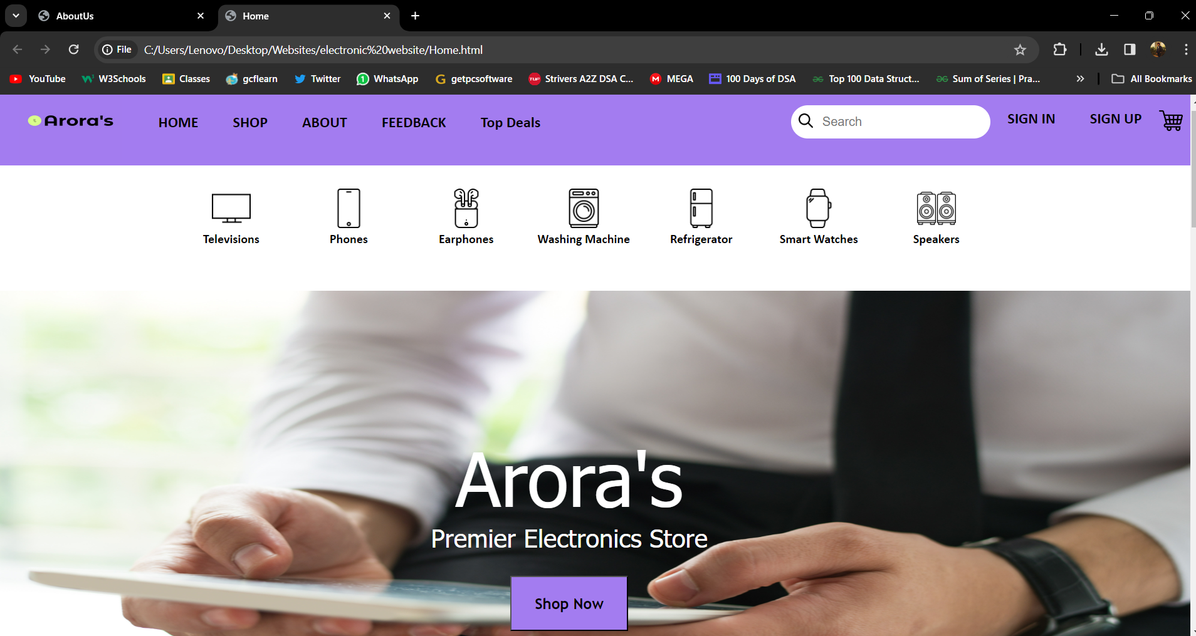
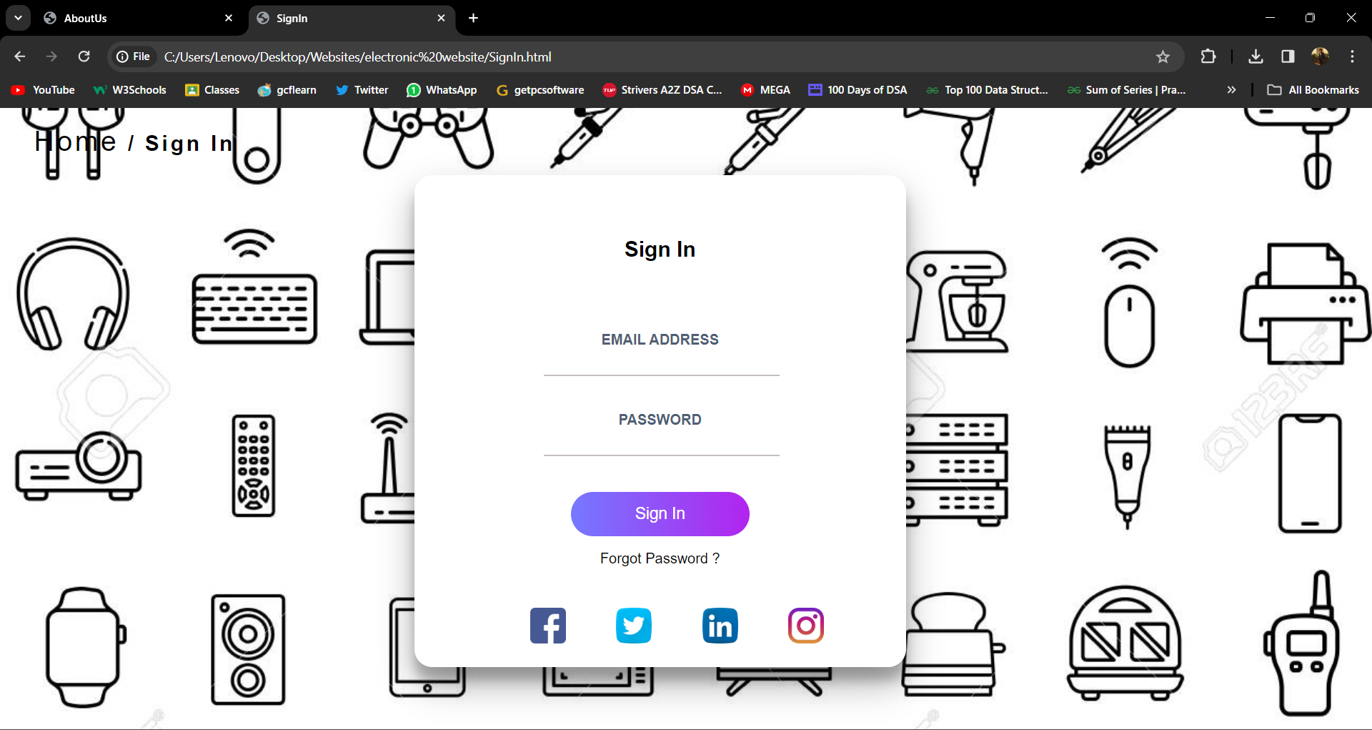
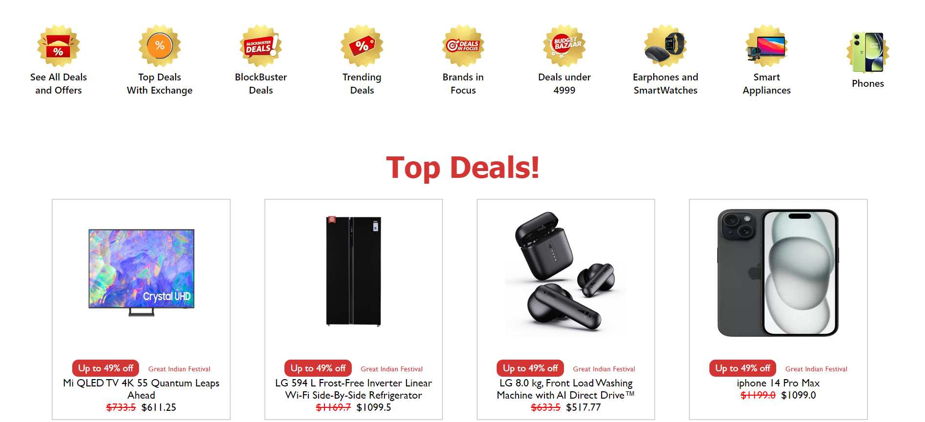
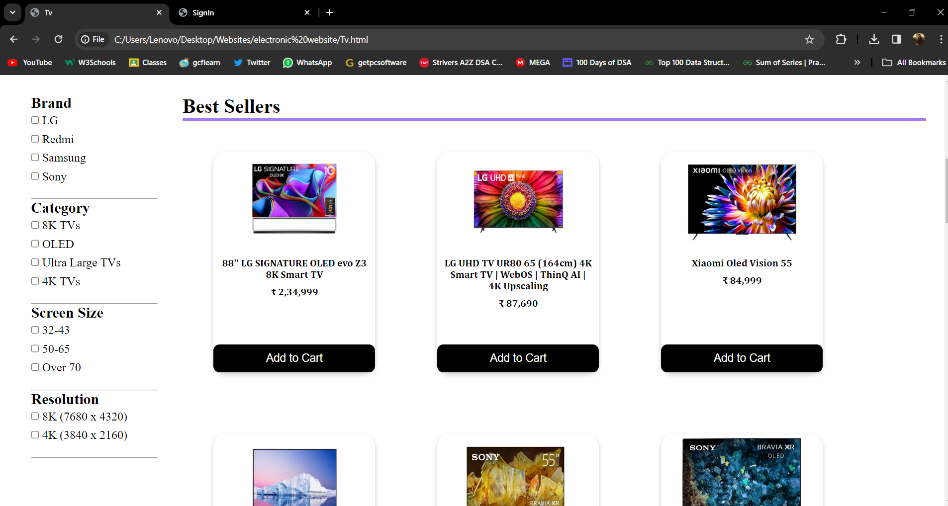
SCREENSHOTS

Slide 8

Future Plans:
Mobile App
Social Commerce
Voice Commerce
Expanding Product Offerings

Slide 9
Thank You

